Slide 1
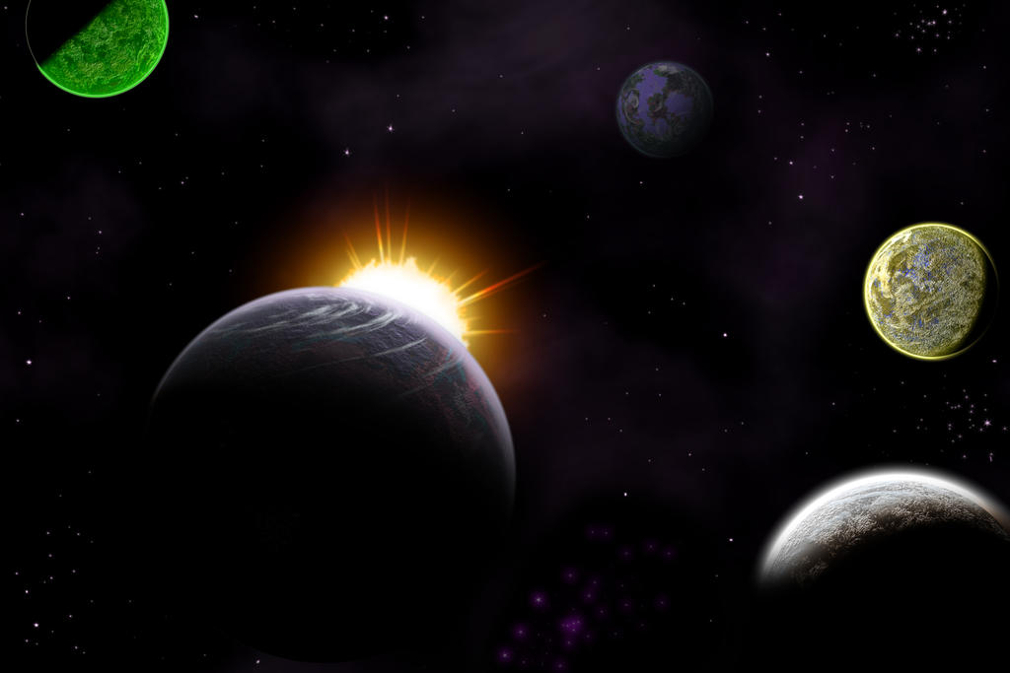
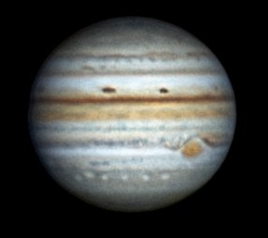
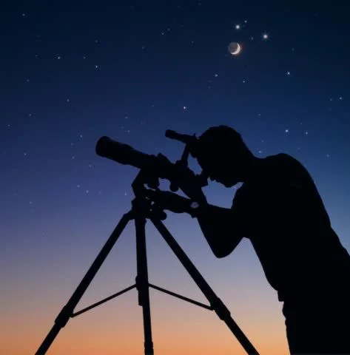
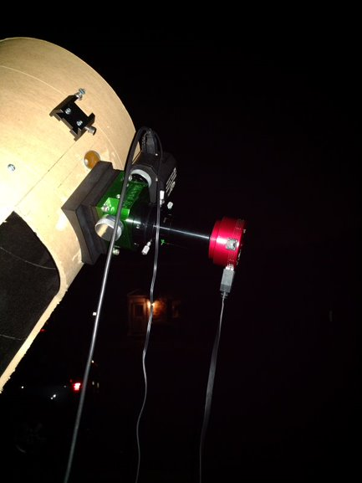

Jupiter
Big Fun for the Amateur Astronomer!

Slide 2

Jupiter is one of the most popular planets for amateur observers
What’s the attraction?
Notes:
The data is unambiguous – Jupiter is a very popular target! Looking at the number of reports submit to ALPO over a two year period, the contest is not even close.
* So what lies behind this popularity? Why do so many amateurs take the time to observe and document what takes place on the 5th planet from the Sun?

Slide 3
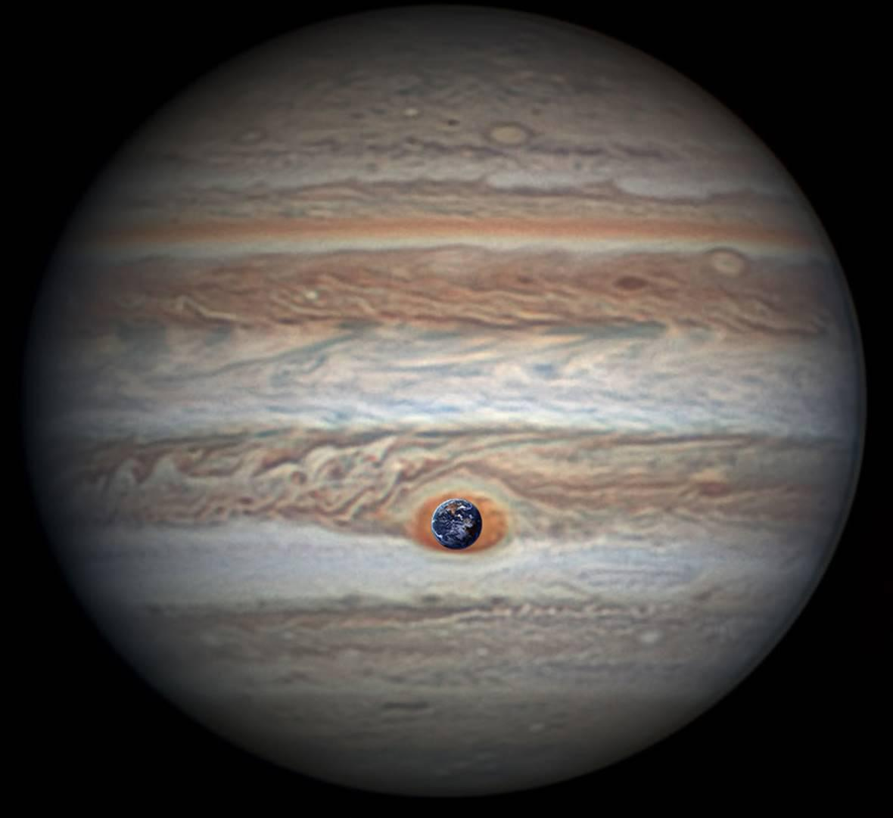
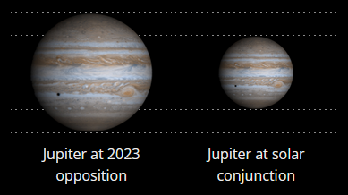
Size!
Equatorial = 44,425 miles; Polar 41,540 miles
  Can fit over 1,300 Earths inside Jupiter
  In fact, even the Great Red Spot (GRS) is larger
  than our home planet!
Telescopic size at opposition
  Orbit Eccentricity 0.049 (Earth 0.017)
    Aphelic opposition: 43 arc-seconds (507M)
    Perihelic opposition: 50 arc-seconds (460M)
      November 1, 2023 (Aries)
  Smallest (Solar conjunction): 30 arc-seconds
Fun Fact!
Credit: NASA
Credit: In-the-Sky.org
Notes:
The first attribute that makes Jupiter a popular target is its size, 41K by 44K miles
* Given Earth’s diameter is 12.75K, Jupiter could hold 1,300 Earths
* And even though it’s been shrinking, even the GRS is larger than our home planet*
* This leads to a nice size in the eyepiece. Of course it is at its largest at opposition and when at perihelion in its orbit, but even when nearing Solar conjunction and on the opposite side of the Sun from us, it still beats the angular size for most other planets

Slide 4
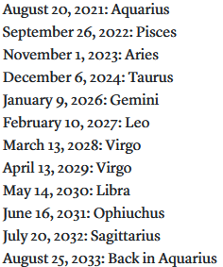
Visibility!
Reliably observable 8 months of a year
11.86 years to complete an orbit with synodic period of 399 days (1.09 years)
  Given 12 signs of zodiac, it advances one sign each year, returning to opposition every 13 months
  No opposition in 2025
Fun Fact!
Sky & Telescope 08/20/2021
Notes:
* It takes a dozen years to lap the Sun, which given we have 12 Zodiac constellations means Jove visits one a year
* Interestingly, there will be no opposition in 2025

Slide 5
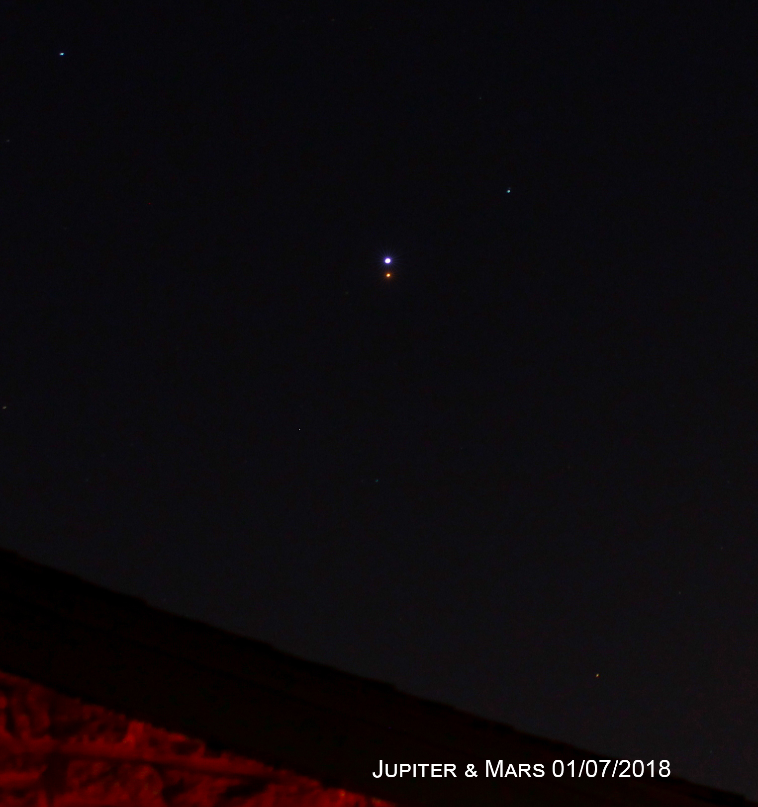
Bright!
4th brightest object (-2.9 at opposition)
Makes for great conjunctions when pairing with the other bright objects
Makes imaging easier (higher fps possible with lower gain)
At the eyepiece when visually observing you want a filter to reduce that brightness
Notes:
(read slide text - 3 clicks)

Slide 6
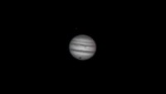
Cool Features!
Galilean satellites are easily seen and perform transits, eclipses, and occultations with Jupiter
Cloud bands change appearance from apparition to apparition
Storms like Great Red Spot (GRS) persist for years and sometimes merge
Notes:
Jupiter’s 4 largest moons, collectively termed the Galilean satellites, are easy to see and interact with the planet as you can see in the video here. They can pass in front of Jupiter (a “transit”) and cast their shadow onto the cloud tops below. We can also see them enter into or emerge from Jupiter’s shadow in an eclipse event. At certain points in Jupiter’s orbit we can even see them occult and eclipse one another.
* In addition to the moon dance, Jupiter’s cloud bands are always on the move, often changing appearance from year to year.
* And large, enduring storms in its atmosphere can be seen in many amateur telescopes

Slide 7
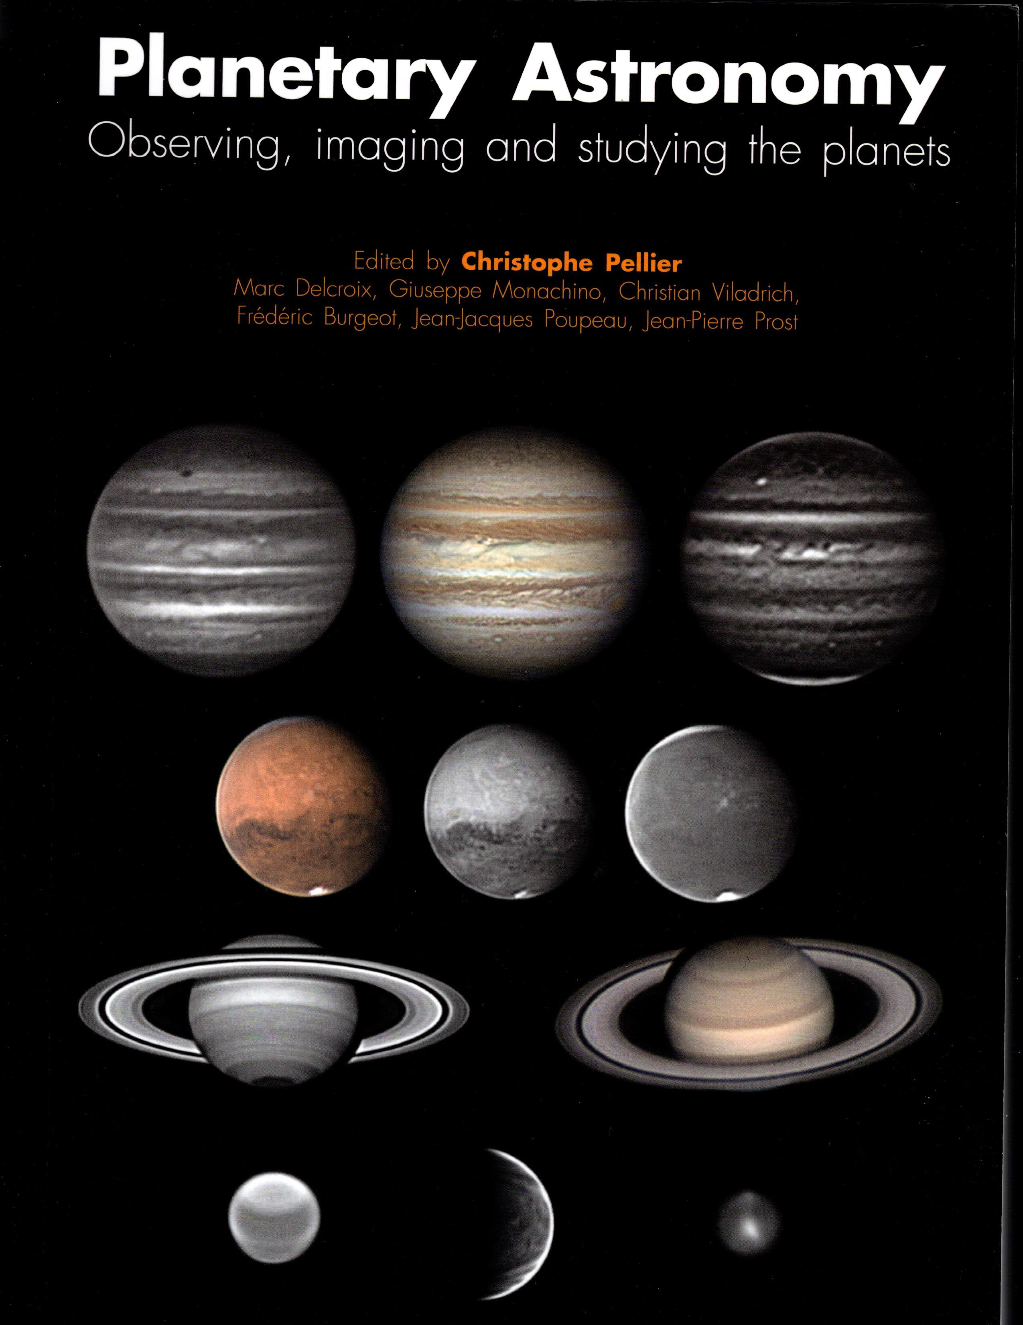
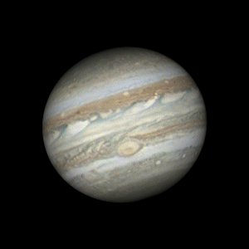
Jovian Nomenclature
An orientation to Jupiter’s features
Notes:
In order to get everyone on the same page I’m going to take a couple minutes to talk about how we organize the features we see on Jupiter. As an aside, if you want a deeper dive into Jupiter or really any of the planets I highly recommend Planetary Astronomy by Pellier – it has a wealth of information.

Slide 8
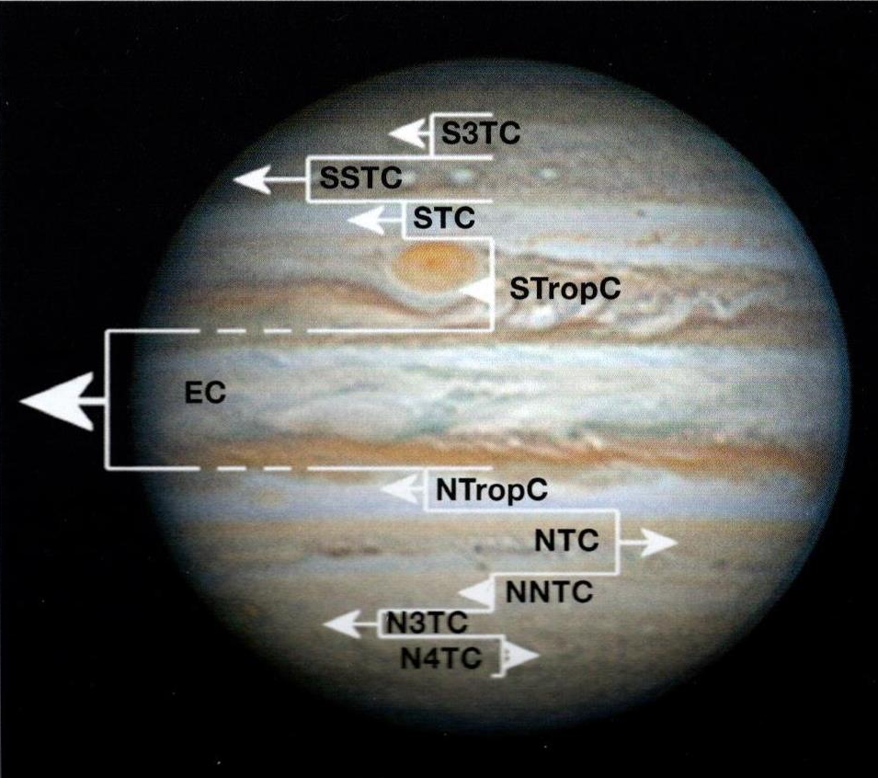
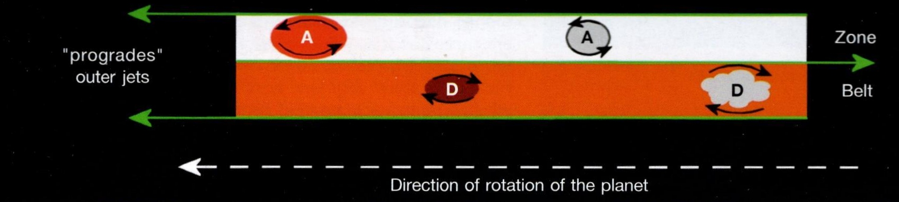
Belts & Zones
Jupiter’s fast rotation sets up very strong E-W jet streams in its atmosphere.
  There are 16 Prograde jets rotate with the planet
  There are 5 Retrograde jets rotate against the rotation
  Their combination sets up a slow moving current – the pairing of a belt and zone into a domain that carries along features within it.
These currents move at different speeds (faster towards equator) – so you can see features catch up to and move past features in adjacent currents
Notes:
Given Jupiter is basically a fluid body with the fastest rotation rate of any planet in the Solar system, the planet has multiple strong jet streams that shape its countenance
* There are 16 prograde jets – that is, rotate with the planet
* And 5 retrograde jets that run counter to the rotation
* This combination sets up a series of domains – the combination of a zone (white) and a belt (brownish) – that forms a slow moving current that carries along storms like the GRS
* Looking at the whole planet then we have 10 identifiable currents shown here in this diagram from Pellier’s book
* Since the currents closest to the equator are the swiftest, you can see features catch up and pass one another over time.

Slide 9
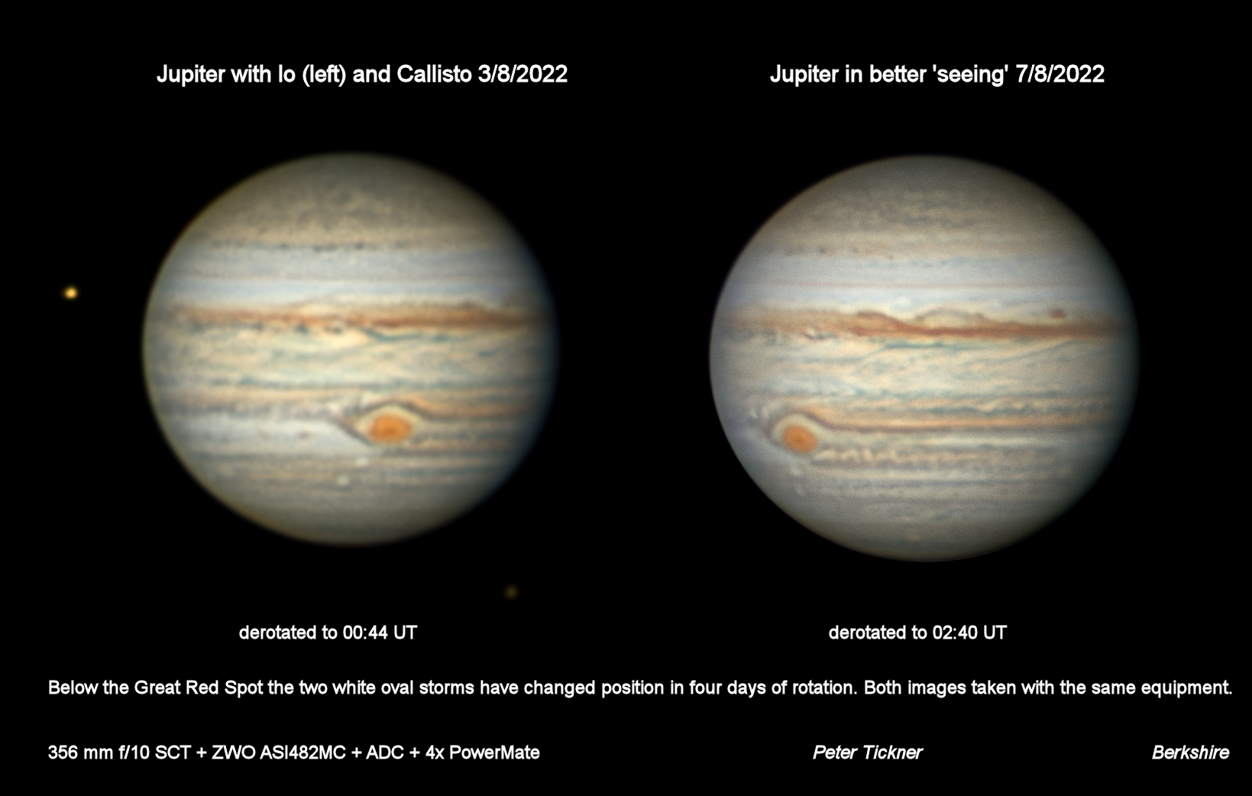
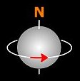
Notes:
- Here we see a nice example of the rotation differences based on latitude in just 4 days. The white oval closest to the GRS (“STZ-AWO”) is trailing the spot below it (“A1”) on the left, but has pulled even to it on the picture on the right

Slide 10
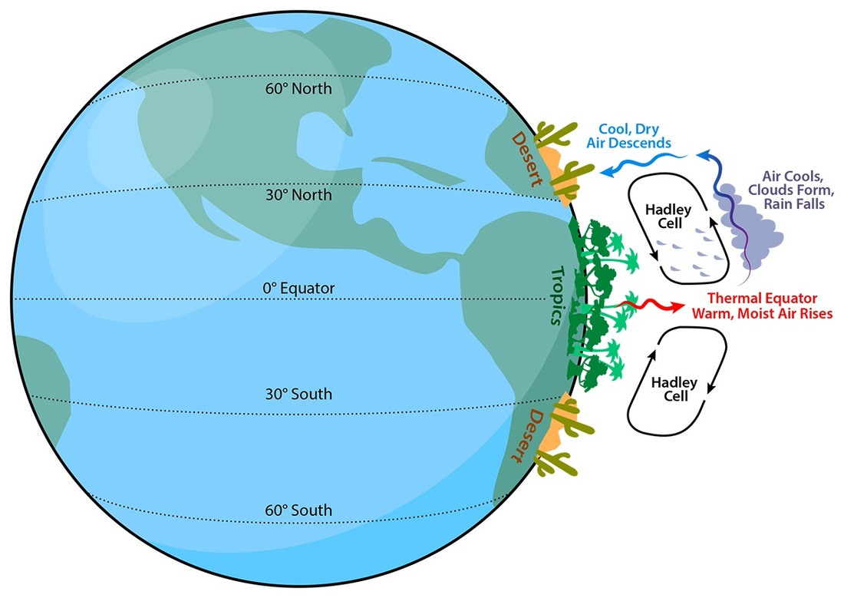
Belts & Zones
A pairing of belt & zone forms a large unit of atmospheric convection, a “Hadley Cell”
  Vertical circulation of the air due to temperature differences. Warm air rises, cools, and then sinks.
  The white zone represents ascending
  air that forms ammonia ice clouds,
  while the belt is dryer, descending
  air where the white ammonia ice
  has dissipated to reveal a deeper
  layer of the atmosphere
Notes:
Read slidec

Slide 11
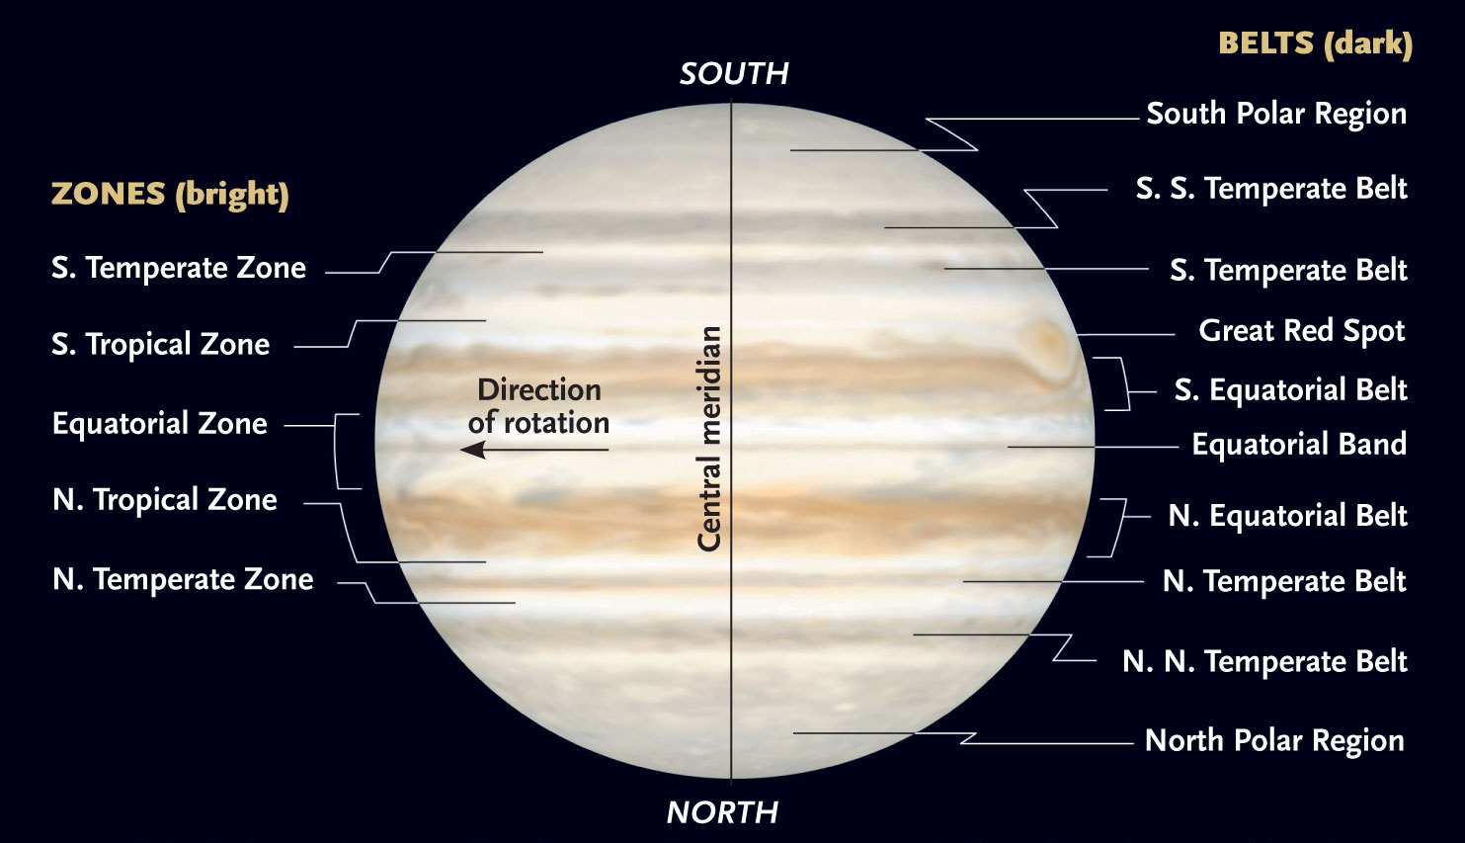
Credit: https://skyandtelescope.org/astronomy-news/observing-news/jupiter-at-opposition-3020420153/
Notes:
In this diagram we see the major belts and zones for Jupiter.

Slide 12
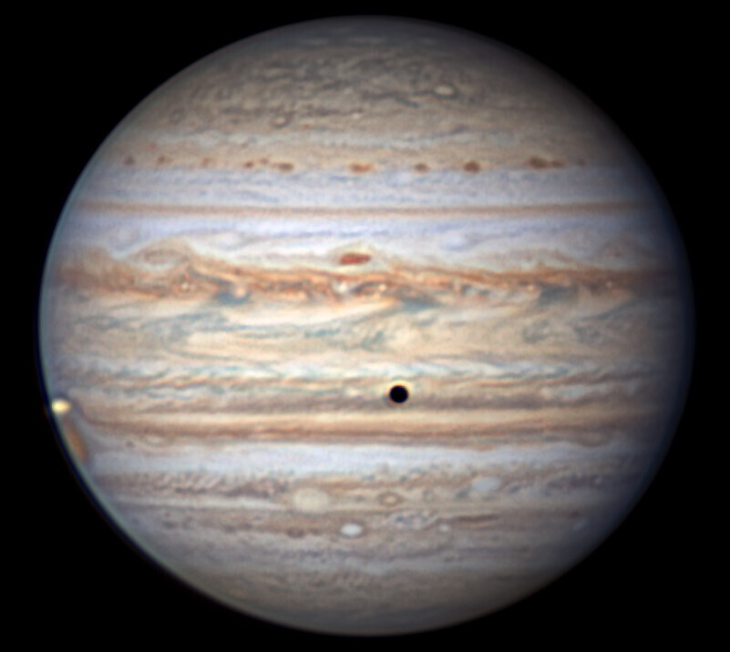
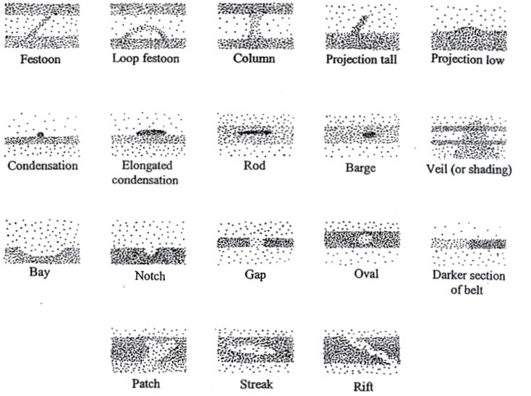
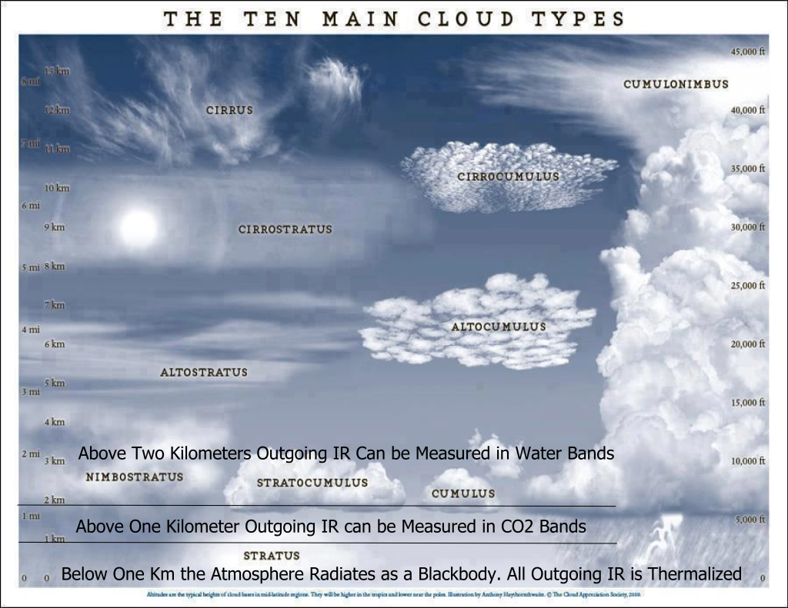
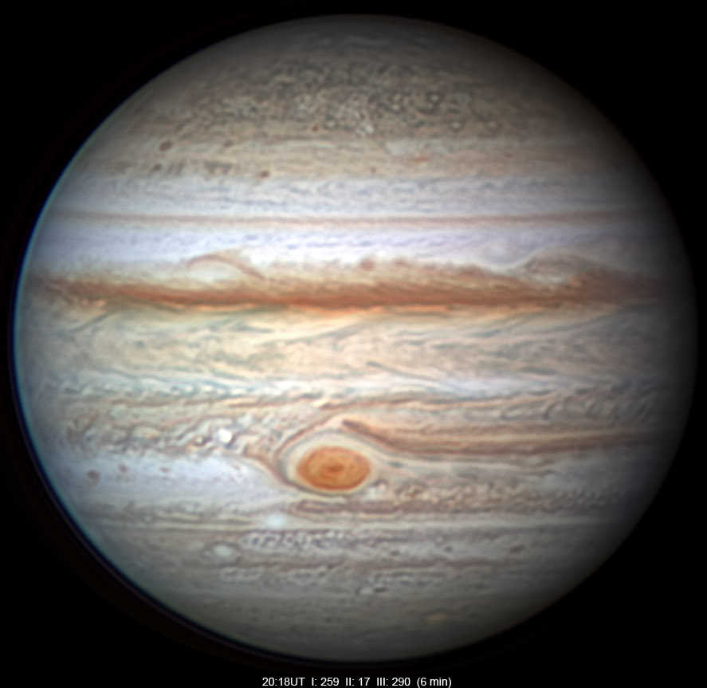
Nomenclature
Credit: Observing Jupiter in 21st Century
Credit: Christopher Go
Notes:
Without a solid surface, we are looking to describe cloud features, not unlike how meteorologist on Earth have catalogued clouds
* Here we see some of the common features that a keen eyed observer can pick up among the Jovian clouds. The two images to the right were taken by amateur Christopher Go out of the Philippines, and in them we can catch a handful of these features
* 6x

Slide 13
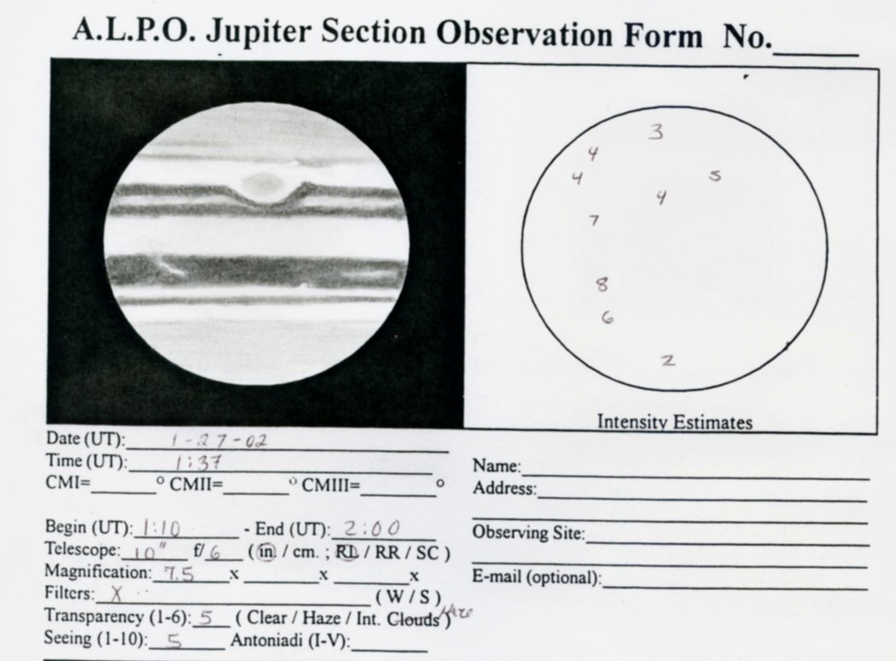
Visual Observing
Jupiter at the eyepiece
Notes:
So now that we’ve established why Jupiter is a fascinating target and are oriented to its features, let’s explore what you might see at the eyepiece

Slide 14
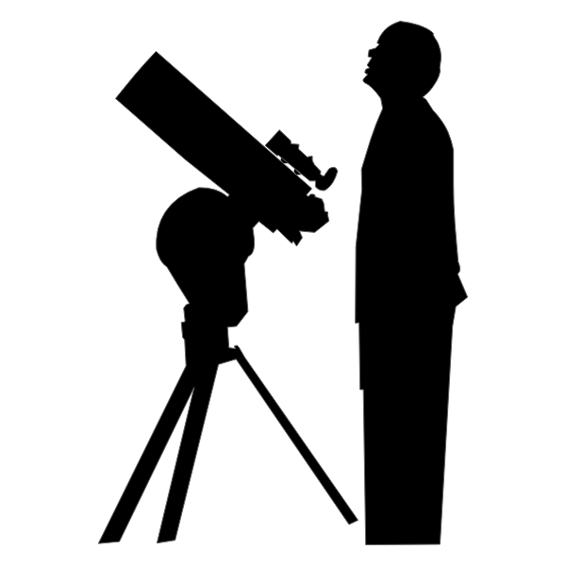
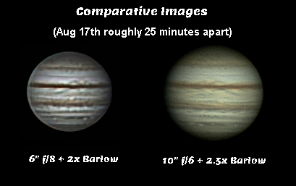
What’s Needed?
Telescope
  While some factors such as central obstruction can make one telescope type superior to another at equivalent aperture, size is still the primary factor in what you can see
  Collimation is important
Quality Eyepiece (10-5mm)
Stable mount
Optional (but recommended)
  Tracking so that you can observe the planet for a long period of time
  Filters (Yellow helps overall; blue can help with GRS)
Steady seeing!!
Patience
Notes:
* read slides (ends with Patience)

Slide 15
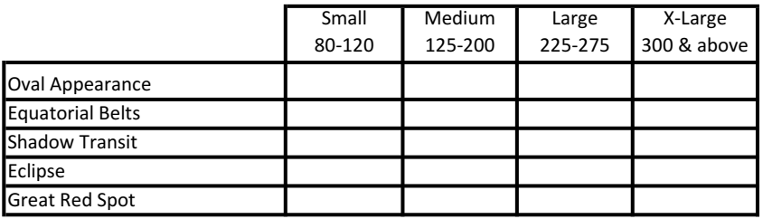

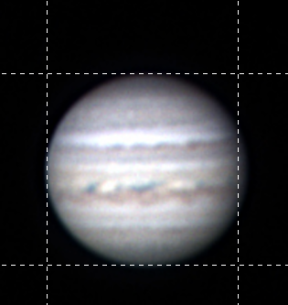
The Easy Stuff
Jupiter has the fastest rotation rate of any planet – just under 10 hours
  Equatorial region (System I) 9h 50m
  Elsewhere (System II) 9h 55m
This centrifugal force causes a bulging at the equator
Notes:
Can you see the planet’s bulging at the equator? Because of the high rotation rate and the planet not being substantially solid, the centrifugal force causes the planet to appear slightly oval. It’s subtle but you can notice it, even in a small scope.
Also note that because of this fluid nature the planet has two systems of longitude; System I for the equator and System II for temperate/polar areas.
There is a System III based on radio broadcast emanating from the suspected solid core; it is only a few seconds shorter than System II and is regarded as the most objective.

Slide 16
The Easy Stuff
The North Equatorial Belt (NEB) is usually the thinner of the two, but more intense in its color
  It is currently very thin – we are monitoring for a “revival that may come this year or next
The South Equatorial Belt is usually wider and not as prominent….
but not always!
Notes:
The equatorial belts are by far the most prominent feature and apparent in even small scopes as shown here.
* The NEB is usually the thinner but more intense of the two.
* Right now, it’s even more thin than usual, with its northern half having faded away. John Rogers from the BAA states that it could be ready to undergo a revival where it increases its width, or it may not happen for a year or two. Regardless, looking for changes in this belt is indicated!
* The SEB is usually wider, even when the NEB is at full form, and usually not quite as intense. But, like so much with this dynamic planet, that statement does not hold true sometimes

Slide 17
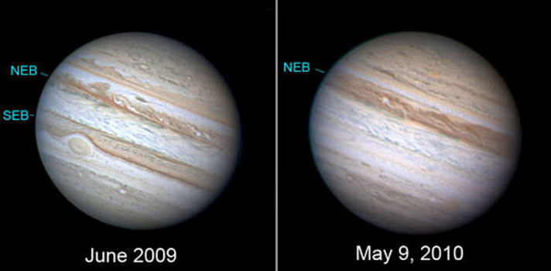
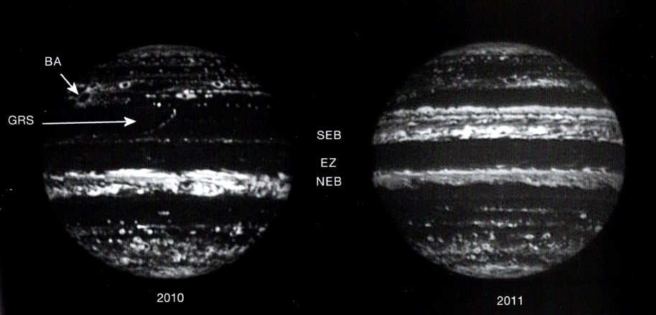
The Great SEB Disappearing Act
Every ~15 years the SEB undergoes a set of two fadings over ~4 years
For some reason, the convection stops and the belt cools, covered by ammonia clouds
Last episode 2010 – getting near another episode?
Credit: Anthony Wesley
https://news.softpedia.com/news/Jupiter-Loses-Its-Southern-Equatorial-Belt-141942.shtml
Notes:
There is a pattern where, for some reason, the convection between the SEB and the STrZ breaks down (possibly the internal heat source undergoes a change. The SEB becomes covered with white ammonia ice (and the GRS becomes more prominent in appearance). Eventually a barge in the faded belt appears to erupt and quickly return the belt back to its brown color.
* The last incident was in 2010, so we may be coming up on another event in the next couple of years.
* In this view from the Hawaii Infrared Telescope shows a cooler SEB in 2010 compared to its revived state the following year.

Slide 18
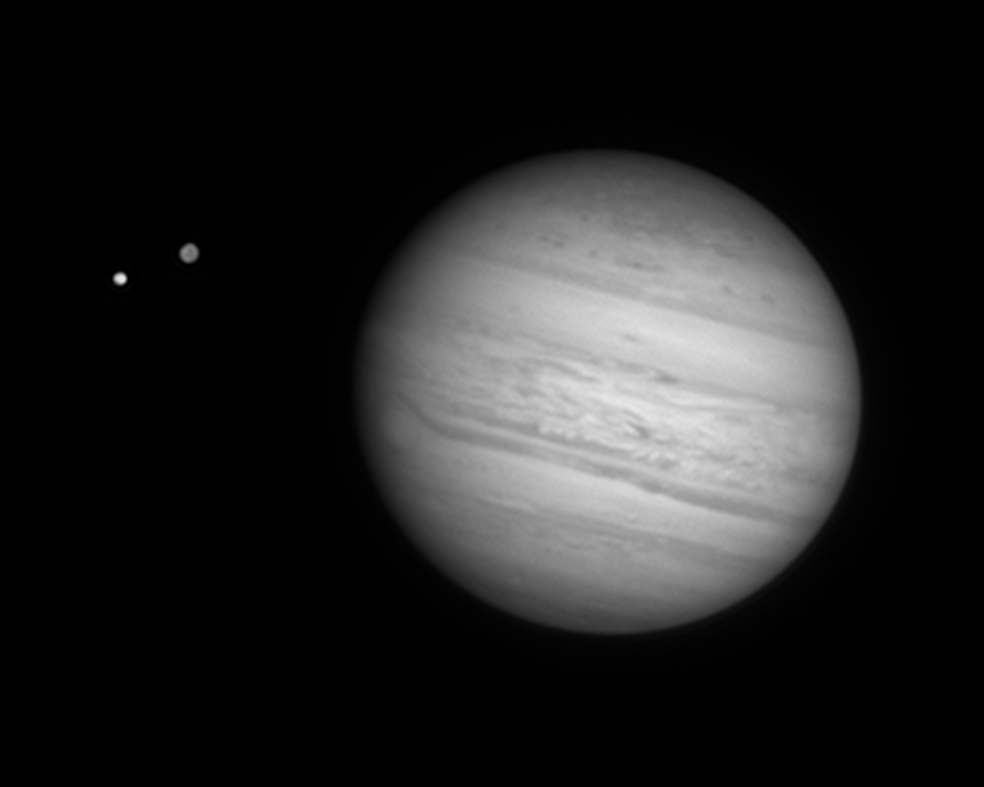
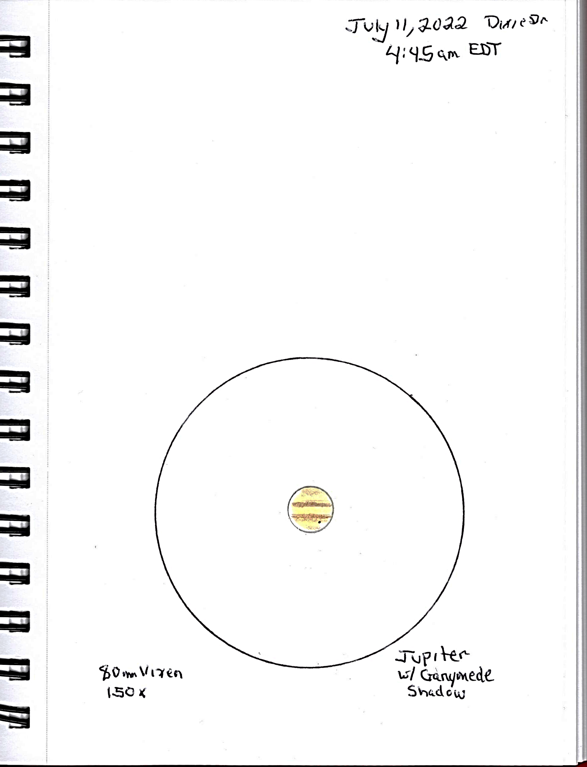
The Easy Stuff
Ganymede provides the most prominent shadow due to its size
Io is the most frequent transitor
Best time for eclipse is at quadrature (3 months before or after opposition)
“Mutual Events” every few years at Jovian equinox (2026)
Credit: Clyde Foster
https://skyandtelescope.org/wp-content/plugins/observing-tools/jupiter_moons/jupiter.html
Notes:
The activities of the Galilean moons is another instance of low hanging observational fruit.
* Ganymede is the largest moon and casts a massive shadow on the cloud tops, something that can be seen in a small refractor as shown in my sketch here.
* Events are fairly common – with Io the most frequent transitor and Calisto the most uncommon. The S&T link below is a great resource where you can key in date & time to see any satellite events.
* The worst time to catch an eclipse phenomenon is at opposition as the planet’s shadow is blocked from our vantage point; the best time is a quadrature when we see the maximum shadow is present off to one side or the other of the planet.
* We also have “Mutual” events where one satellite can eclipse or occult another in the course of its orbit. This only happens around Jovian Equinox, which happens next in 2026. The video here shows one moon entering into the shadow of another.

Slide 19

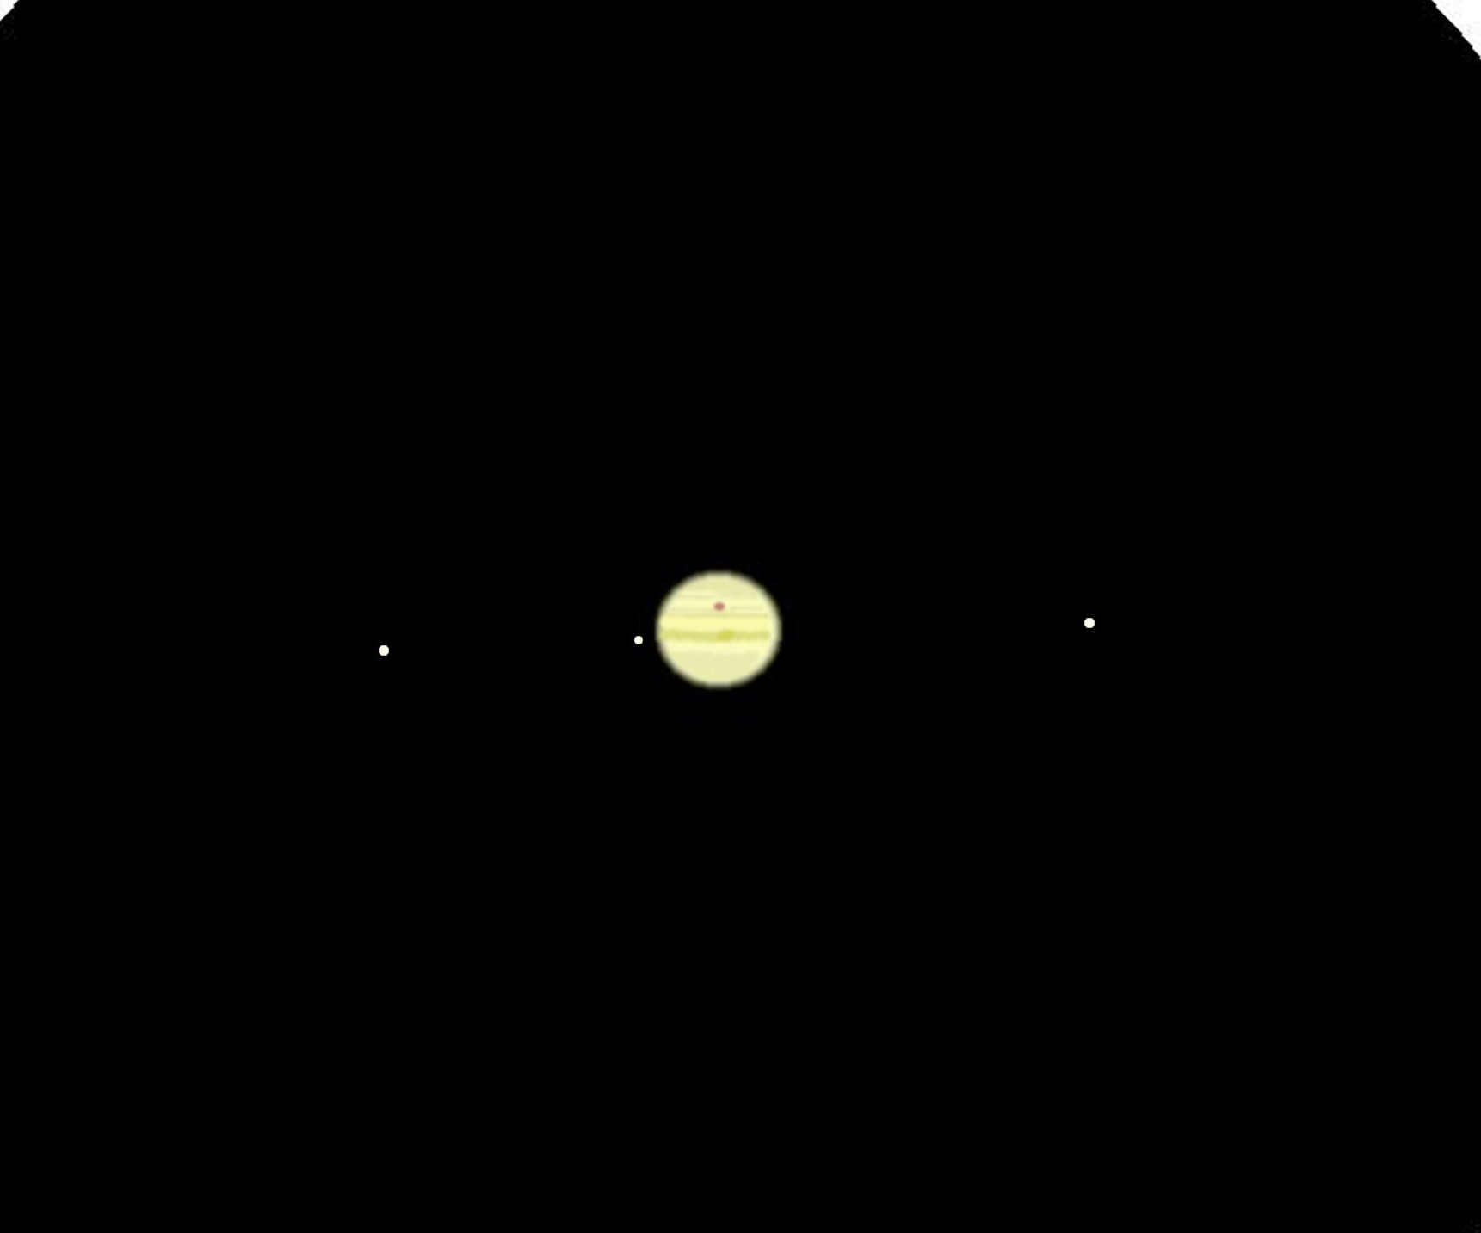
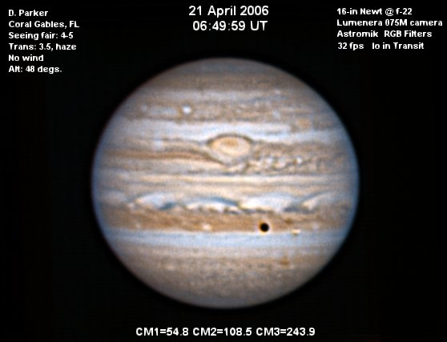
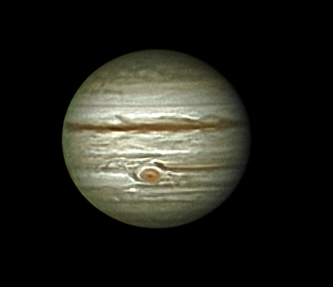
The Easy Stuff
Credit: Tomney - Jupiter 80mm Vixen 150x
Credit: Don Parker
Credit: Jim Tomney – July 2022
https://skyandtelescope.org/observing/interactive-sky-watching-tools/transit-times-of-jupiters-great-red-spot/
Notes:
As for the GRS, Jupiter’s most iconic feature, it is currently large enough and red enough that you can see it in a quality small telescope.
* Here’s a sketch of Jupiter with the GRS on the central meridian using my Vixen 80mm refractor from last year
* The reason I say you can see it “currently” is that right now the GRS is fairly prominent, but there have been times where it fades dramatically. This image from the late Don Parker shows how weak it looked back in 2006. That’s dramatically different compared to its appearance now as you can see in an image from last month.

Slide 20
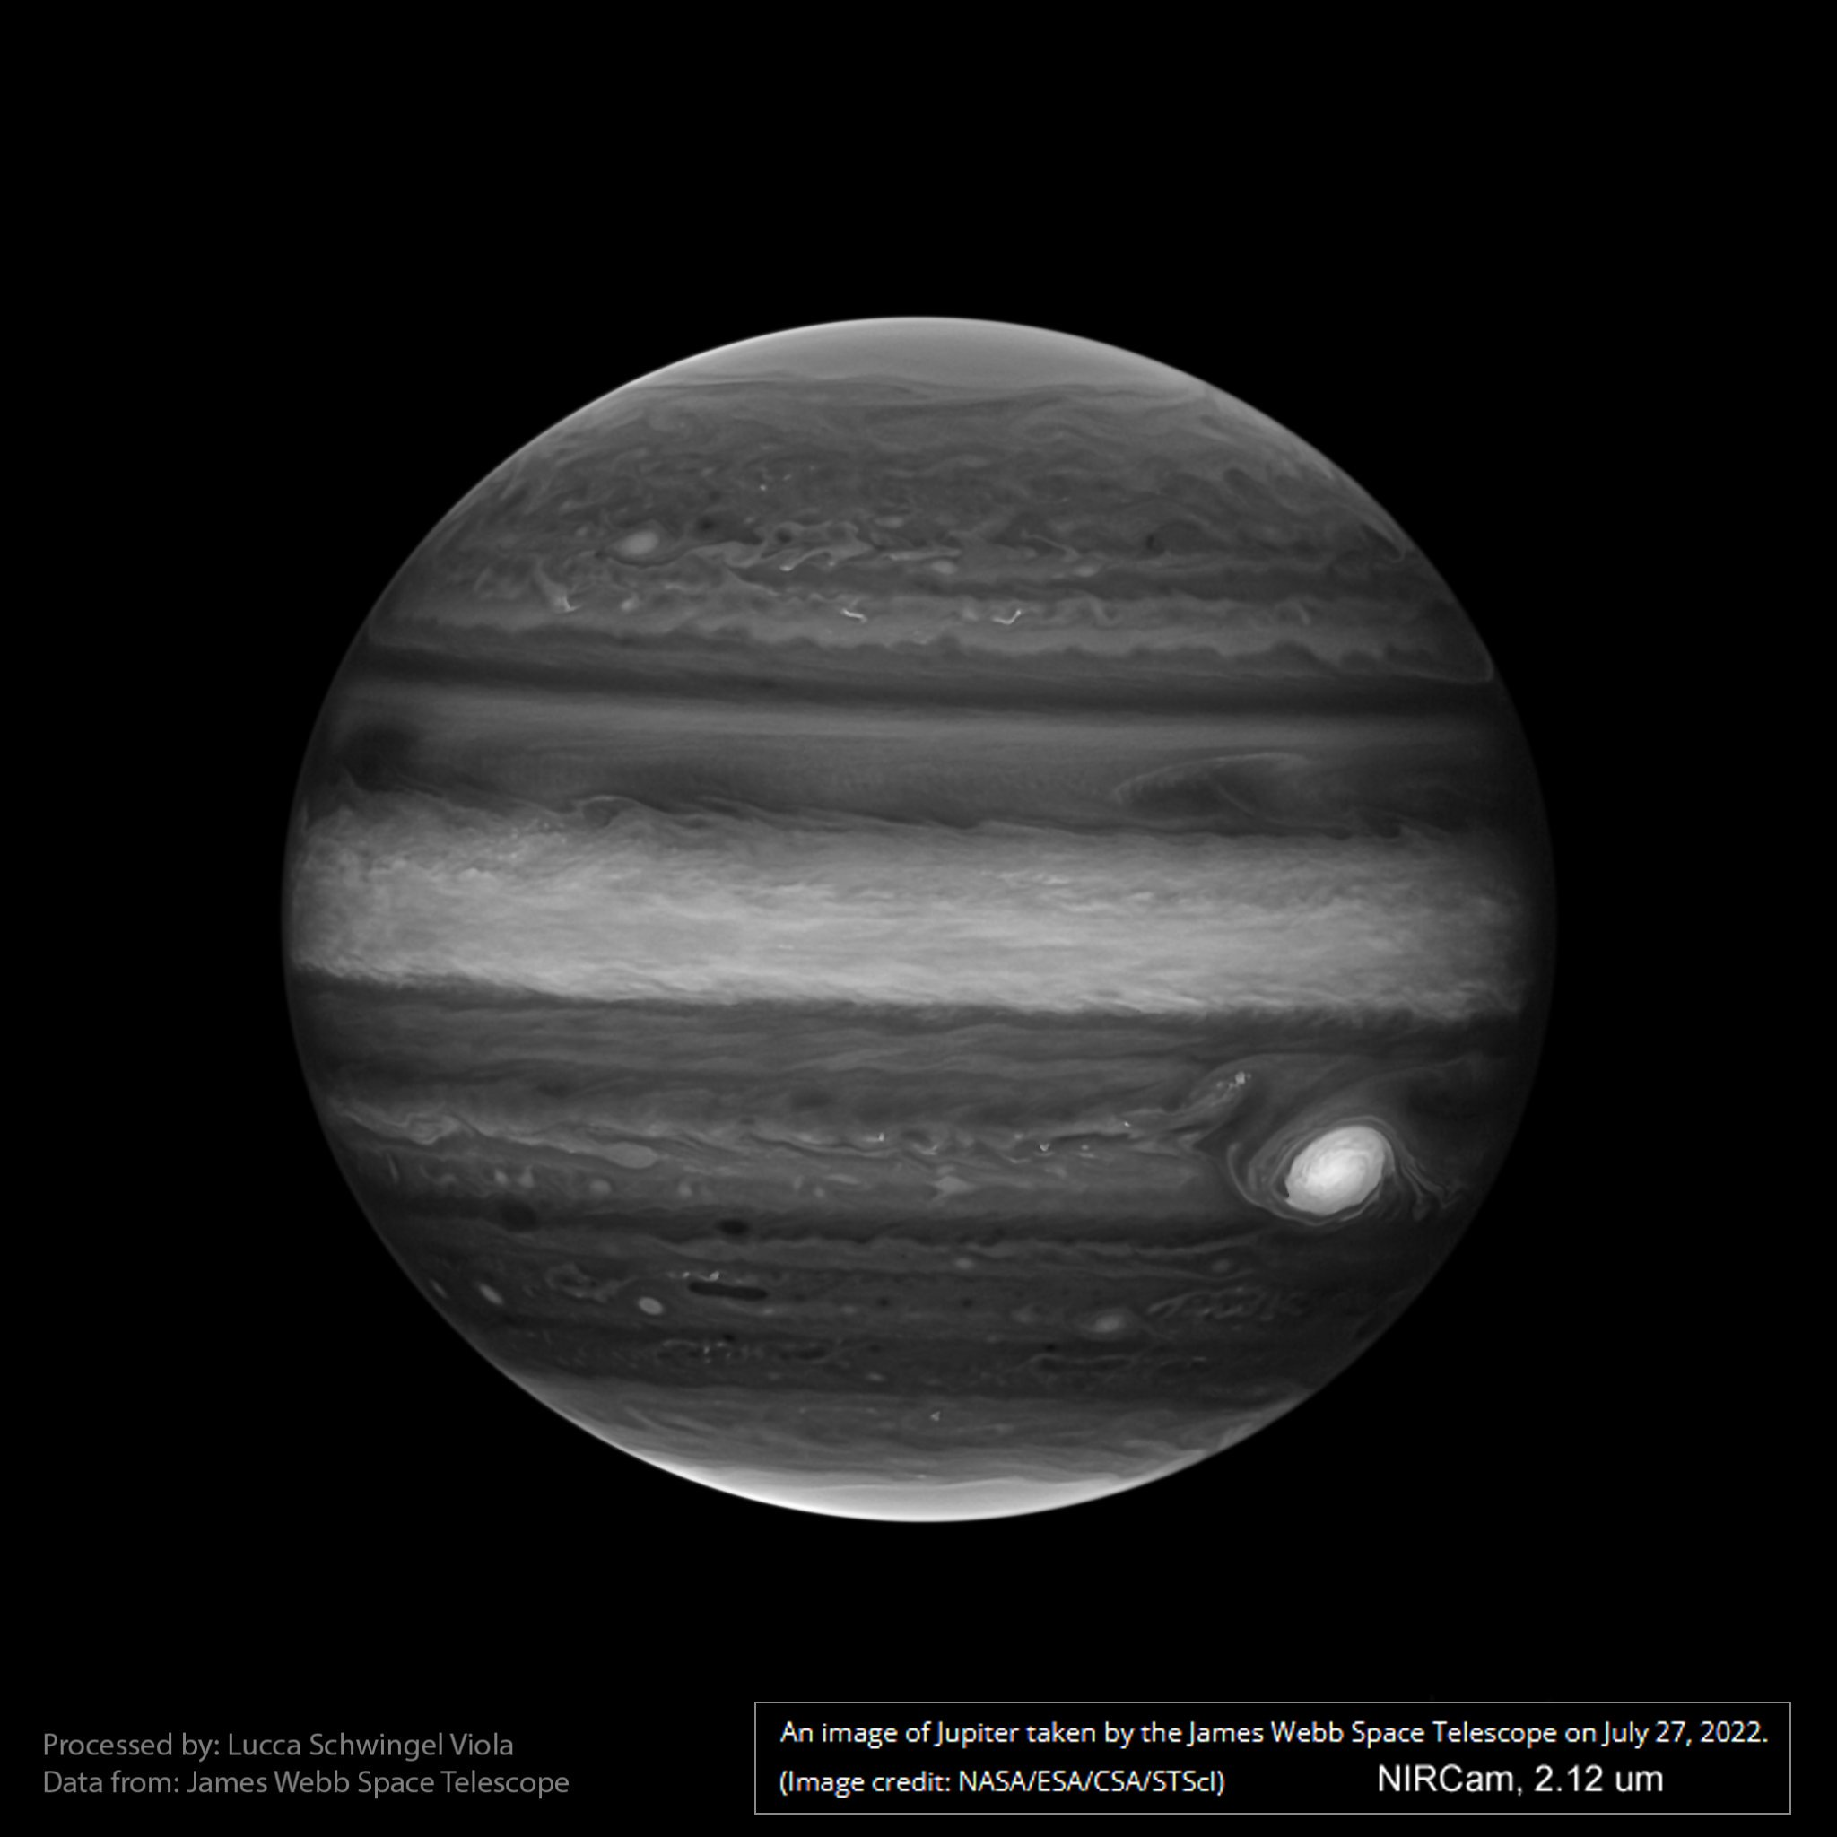
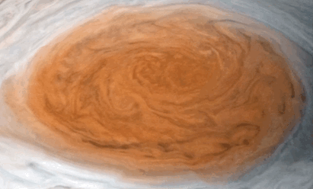
Great Red Spot
The GRS is an anti-cyclonic storm some 1.3 times larger than the Earth that has been around for centuries.
It towers above & below the cloud tops
Notes:
Let’s pause a moment to talk a little about the Great Red Spot which is the iconic feature in the public’s mind when talking about Jupiter.
The Great Red Spot (GRS) is an anti-cyclone, a storm with winds rotating around a central high-pressure region. Its winds rotate counterclockwise at up to 270 mph. Records unambiguously show that it has been around since the 1800s at a minimum.
* The storm towers some 5 miles above the Jovian cloud deck. This can be seen in images of the GRS taken in the methane band where bright objects are higher in the atmosphere. Originally hypothesized as a flat, pancake entity, Juno's microwave radiometer gave scientists a 3D look at the planet in 2019 and found it is anywhere from 186 miles to 310 miles deep, much deeper than previously thought.

Slide 21
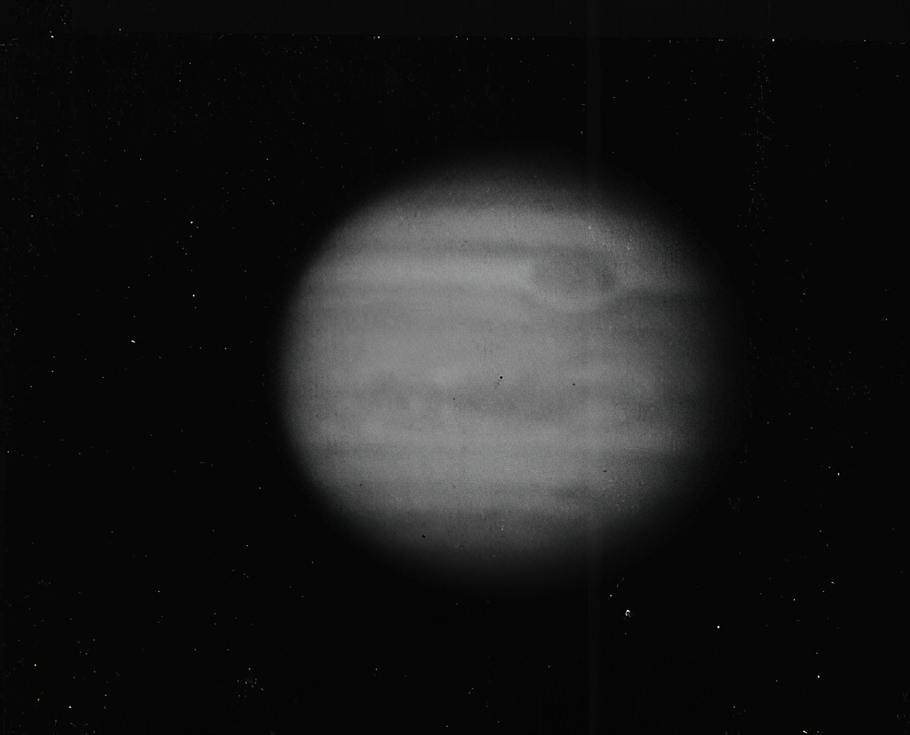
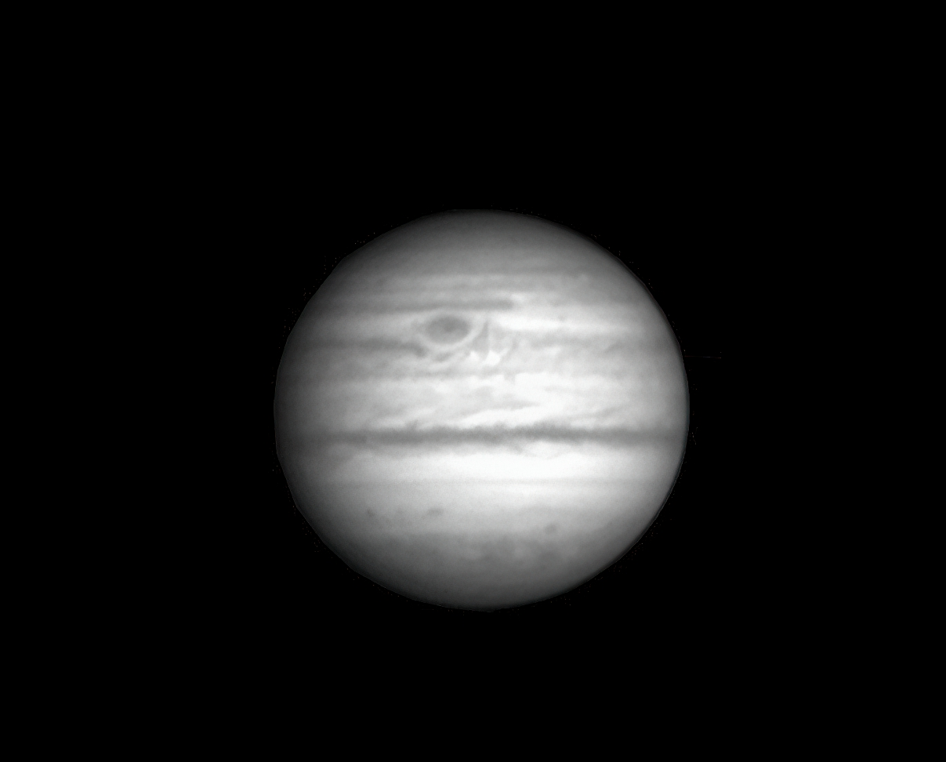
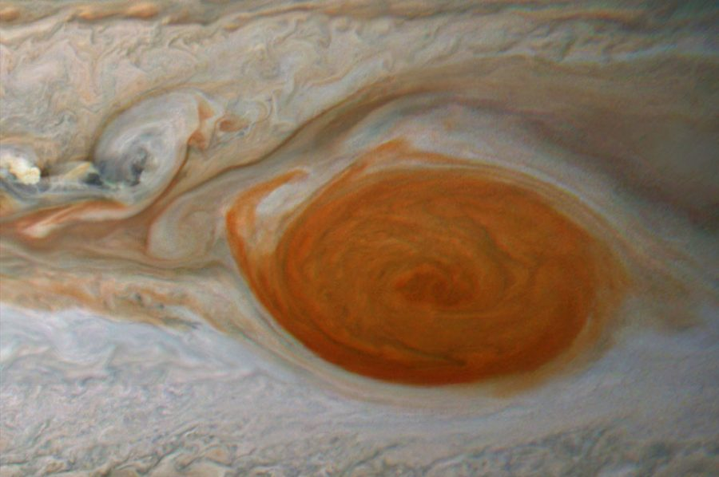
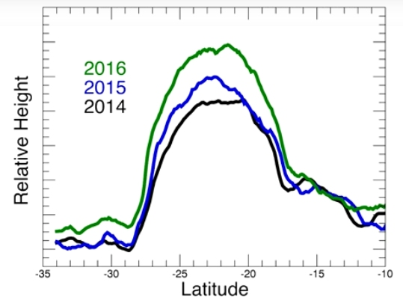
Great Red Spot
Shrinking in Size
  In 1878: 25.5K miles (estimate)
  Voyager 1979: 14.5K miles
  Hubble 2009: 11.1K miles
Flaking
Taller, not faster
Credit: 1964 ALPO archives
R. Schorn using 82” McDonald
Credit: James Willinghan
2022-07-01 using 12” SCT
Credit: Juno Feb 12, 2019
Notes:
As you may have read, the GRS was been gradually shrinking. At one point it could hold 3 Earths, but since 1878 it has downsized to the point where it can just fit just a bit more than one Earth.
* In 2019 several amateur followers of the planet documented “Flakes” being torn away from the spot’s perimeter as it was buffeted by smaller but still powerful storms. We’ve not seen such activity recently but professional and amateur alike are on the lookout for new flaking events.
* However, even with the storm losing area the overall energy of the storm does not seem abated. Scientist had theorized that the spin might accelerate (think of the figure skater analogy). Instead what they have found is that the storm is growing taller, like clay on a potter’s wheel.

Slide 22
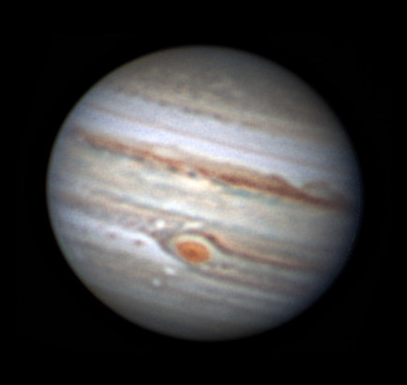
Great Red Spot
Why’s the GRS red?
  In short – we’re not certain
  Perhaps UV generating complex organic compounds?
Credit: Jim Johnson
Credit: Greg Shanos – UV Image
Notes:
Why is it red? Not sure, but in general it is believed that ammonium hydrosulfide & acetylene in the GRS and it lying high above the clouds, the Sun’s UV radiation is forming tholins – complex carbon chains with ruddy color.
* When looking at the GRS in UV light we can see it is absorbing the radiation much more than the other clouds. The fact that the spot has grown more ruddy since 2014 lends some support to the hypothesis, growing taller => more UV radiation to generate more of the compunds

Slide 23
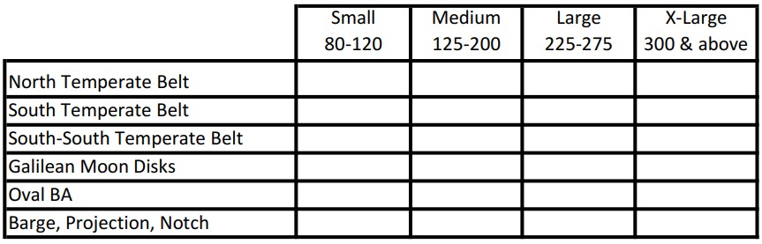


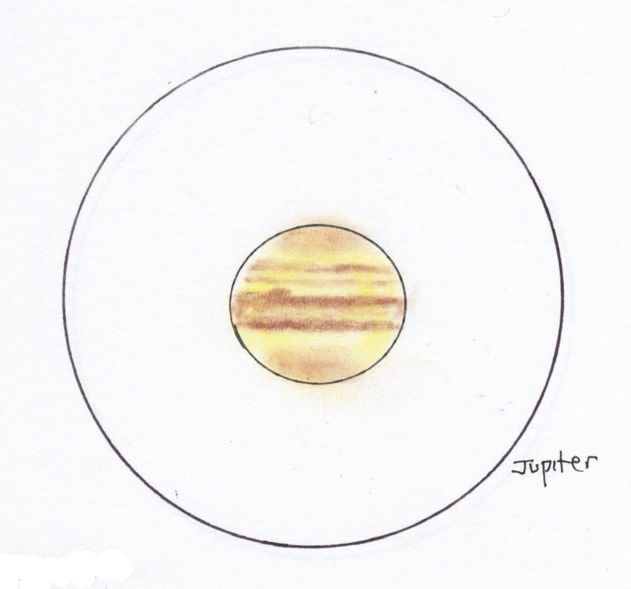
The Subtler Stuff
Notes:
Back to our feature rundown, moving on to the next tier of things that are a little harder to see. The next belts out from the Equatorial belts are the NTB and STB.
* Currently the NTB is a thin thread and light orange in color – totally invisible in my 10” under good conditions. This belt can undergo some fading and revivals, so it bears watching to see if it intensifies as normally it is pretty easy to pick up on in medium size telescope (and perhaps even a smaller scope).
* The STB is generally present and robust enough to be seen in a medium telescope under average conditions. Under really good seeing a smaller telescope might also catch it.
* The South-South Temperate belt is similar to STB; it is quite doable with a medium size scope but a challenge for smaller telescopes.

Slide 24
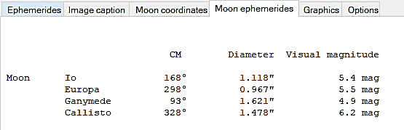
The Subtler Stuff
Can you visually identify Ganymede (largest and brightest)?
Can you pick out Calisto (dimmest)?
Large aperture – any shadings on Ganymede?
Moons are excellent target for checking your focus
Notes:
Certainly seeing the 4 moons is easy. But can you pick up on differences between them?
* Largest
* Dimmest
* Markings?
* Great for focusing

Slide 25
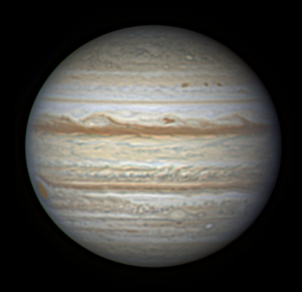
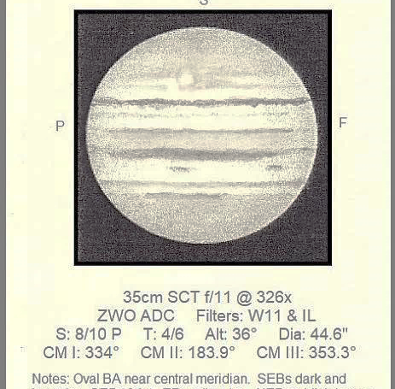
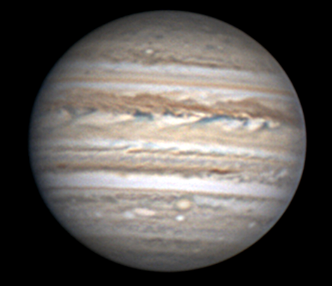
The Subtler Stuff
Hot Spot!
Credit: Christophe Pellier
6/12/18 12” Newt
Credit: Gary Walker
7/29/22 10” Cass-Mkstv
Credit: Michael Rosolina
14” SCT
Notes:
After the GRS, the next largest storm on Jupiter is Oval BA. It is probably a little too tough to observe in smaller apertures, but a medium aperture under good seeing with BA near the meridian should be doable. An as an aside, here’s where a filter might help a little, because anything that can boost your contrast of these subtle features improves your odds of seeing it.
Oval BA is certainly not static, and at times it is a bit easier to see (compare Pellier’s image from 4 years ago)

Slide 26
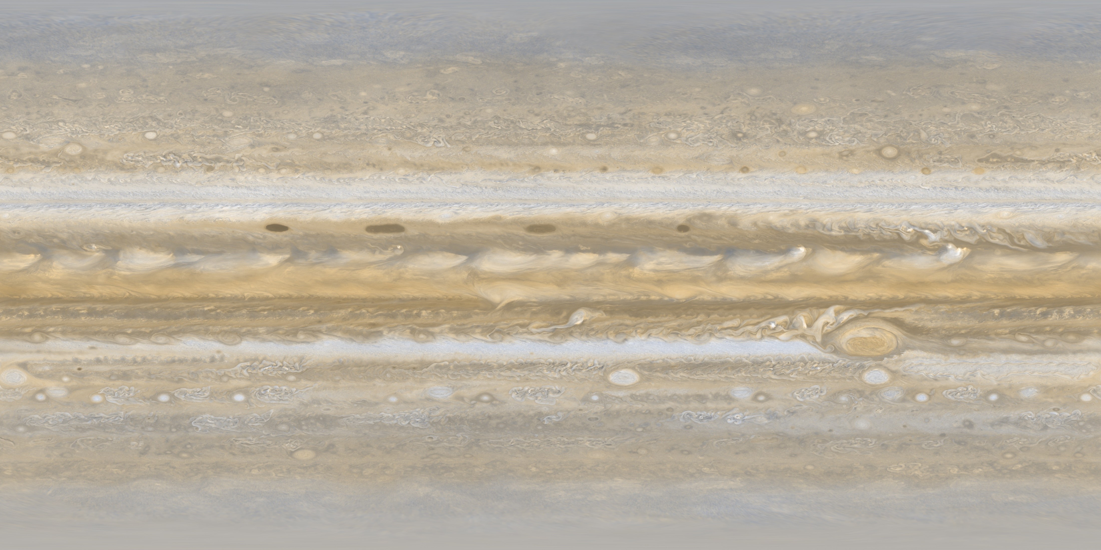
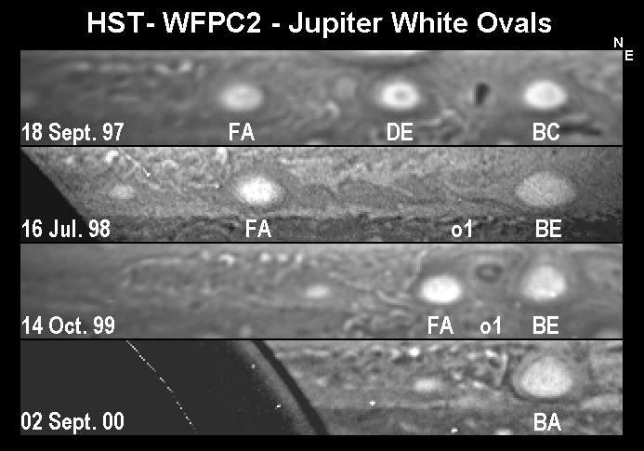
The History of BA
Oval BA is actually the product of 3 large ovals in the STB that emerged in the late 1930s.
  For 60 years they drifted about the belt. When approaching one another they would somehow slow down or even reverse course.
Late 1997/early 1998 while near Solar conjunction, DE and BC did collide and merge (2nd panel)
Finally FA also approached BE and became what we now know as Oval BA
Notes:
Oval BA has an interesting history. In the late 1930s astronomers recorded the emergence of three large, white ovals in the STB which they termed BC, DE, and FA. We can see them here in this image from Voyager 1. For 60 years they drifted about the belt. When approaching one another they would somehow slow down or even reverse course, never colliding.
* That changed in late 1997 when, while under cover of the Sun’s glare of conjunction, two of the ovals (BC and DE) merged to become “BE”
* Finally FA also approached and collided with BE, becoming what we now know today as Oval BA

Slide 27
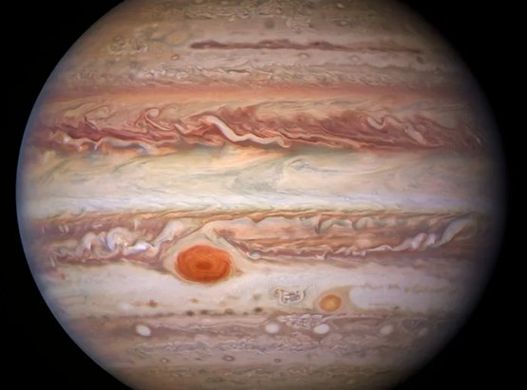
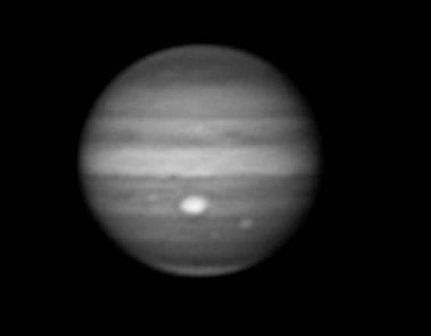
Oval BA – a.k.a. Red Spot Jr.
Credit: HST
Credit: Clyde Foster
Notes:
About five years after the formation of BA, it began to turn red, earning the moniker “Red Spot Jr.” at the time. Currently it’s not very red at all (we see some rose color or very light orange in some images sent in to ALPO) – but that could certainly change.
* Why the red color? Again, if we look at BA in the methane band, this is a feature high up in Jove’s atmosphere, so seems logical the same UV chemical changes may happen in BA also.

Slide 28



The Subtler Stuff
Credit: Jim Tomney
10/5/1997 6” Newt
Barge, Festoon
Credit: Jim Tomney
8/4/2000 10” Newt
Rift, Thickening in NTB, Condensation
Credit: Jim Tomney
9/14/2000 10” Newt
Festoon, Bay, Projection
Notes:
Finally under the slightly more difficult targets, we have the variety of cloud features that we looked at earlier – things like festoons, barges, projections, etc.
* Barges can be quite dark and contrasty, so these you might be able to snag with a small scope and good seeing. Last year in particular the barges were plentiful and intense. Festoons can be challenging for the medium aperture but as shown here they will occasional show themselves
* Likewise, knots or condensations within a belt can be pretty contrasty but not quite so much as a barge., a bit easier to see with medium or larger size telescope. Rifts, which are like a tear in a belt, are also candidates for medium aperture and up.
* This final sketch Shows a bay with a festoon arching over it on the meridian. You are always more likely to pick up a subtle feature when it is at or near the meridian.

Slide 29


The Tough Stuff
Credit: Paul Abel
7/18/2022 20” Dall-Kirkham
A5, A7
Credit: Tom Williamson
7/16/2022 12.5” Newtonian
A5, A7
Notes:
Now we get to the things that can be pretty challenging. Those white anti-cyclones in the SSTB are pretty contrasty, but they are not all that big either. Still, in good seeing and with patience a large aperture should be up for the job, while an extra-large will have an even easier time of it. Again, patience is the key in seeing these features. And none of this is in stone – on a good night you might catch one of these ant-cyclones in a medium sized instrument.

Slide 30
The Tough Stuff
Credit: Paul Abel
8/23/2021 12” Newtonian
NN-WS-6, WS6,BA, SSTB Anti-cyclones
Credit: Gary Walker
9/28/2021 10” Cass-Mkstv
NN-WS-6, WS6,BA, SSTB Anti-cyclones
Notes:
- The northern corollary to the SSTB’s white ovals is the occasional storm in the NNTB. That belt is usually not as dark nor are the storms quite as white, so these are lower contrast objects. But always keep an eye out as you never know when one may become more active and readily seen.

Slide 31

The Tough Stuff
Credit: Chris Hooker, BAA
“Observing and imaging the Galilean moons, as they transit the planet's disc, can be a challenging feat. Apart from when a Moon is passing over the darker limb regions, most of them will have a similar albedo to Jupiter's bright zones and, unless seeing is perfect, the Moon will become lost in the Jovian background. The one exception to this is Calisto, which is by far the darkest Moon with an albedo of 20%. (Io, Europa and Ganymede have albedos of 61, 64, and 42% compared to Jupiter's average albedo of 43%.)”
https://www.astronomyclub.xyz/planetary-imaging/the-galilean-moons.html#:~:text=The%20one%20exception%20to%20this%20is%20Callisto%2C%20which,is%20a%20shadow%20of%20one%20of%20the%20moons%21
Notes:
- Finally we have the ability to catch a moon as it cuts across the planet. This is very tough because of the very low contrast between the cloud deck and the surface of the moon. Your best shot is with Calisto, darkest of the 4 Galilean moons. One think you may catch is right as a moon moves off or onto the limb it can be actually quite easy to spot for a few minutes. This is due to the limb darkening effect boosting the contrast between moon and Jupiter for a short interval.

Slide 32

Imaging Primer
Getting Started with Computer Assisted Planetary Imaging
Notes:
- The last 25 years has been absolutely revolutionary for amateur planetary observers with the advent of Computer Assisted Planetary Imaging (“Lucky Imaging”). Similar to deep sky imaging, the armamentarium for capturing images can get very sophisticated (and expensive). What I’d like to do here is take a few minutes and offer some thoughts about how to get started in doing your own CAPI.

Slide 33

What’s Needed to Start?
Telescope
  100 mm or greater in aperture
  f/ratio > 6
Tracking
Color video camera
Laptop for capture & processing
Software (open source)
Optional (but recommended)
  UV/IR cut filter
  Barlow
Steady seeing!!
Notes:
Obviously we need a scope. In general something above 6” but certainly not below 4”, and not fast (above f/6)
* You will want it on a mount that can track (no the same as guiding) – it’s too tedious otherwise
* A color video camera
* A laptop to run the capture software and save the AVI file (will be large)
* Software for capture and processing of your video. Most of it is open source (not sure about Apple platform)
* Optional but a big plus would be a UV/IR cut filter to sharpen the image (may be included in the camera) and a Barlow to enlarge the image
* And, one of the biggest assets, is an evening with good seeing (CSC, Astropheric)

Slide 34

Video Camera
Wide range of providers
  ZWO
  Celestron
  Imaging Source
  QHY
  Orion
Using your DSLR
  Heavy and requires T-Ring adapter
  Only in debayer mode
https://www.highpointscientific.com/astronomy-hub/post/astro-photography-guides/choosing-the-best-planetary-camera
Notes:
There a multiple vendors offering color video cameras for planetary imaging. I’m suggesting a color camera here because doing your capture in monochrome is going to be more tedious and expensive by the time you invest in the RGB filters and color wheel you’ll need to produce a color image.
While the price range is pretty wide you’re probably looking at $175-250 for a camera
* Be sure to check out vendor websites such as Highpoint Scientific for some good background on the pros and cons of the various models
* You could also entertain the idea of using your DSLR to capture video. I’ve done this for some Lunar work but not tried it for planets.

Slide 35

Sample Video Capture Process
Polar align telescope

Slide 36

Sample Video Capture Process
Polar align telescope
Check collimation

Slide 37

Sample Video Capture Process
Polar align telescope
Check collimation
Align finder scope

Slide 38
Sample Video Capture Process
Polar align telescope
Check collimation
Align finder scope
Insert Barlow and camera, check balance

Slide 39

Sample Video Capture Process
Polar align telescope
Check collimation
Align finder scope
Insert Barlow and camera, check balance
Connect to laptop & launch capture program

Slide 40

Sample Video Capture Process
Polar align telescope
Check collimation
Align finder scope
Insert Barlow and camera, check balance
Connect to laptop & launch capture program
Center planet, focus
https://www.youtube.com/watch?v=RDuDjIvtXWI

Slide 41

Sample Video Capture Process
Polar align telescope
Check collimation
Align finder scope
Insert Barlow and camera, check balance
Connect to laptop & launch capture program
Center planet, focus
Set ROI as small as possible
Adjust shutter and gain to get best possible fps rate without grainy frames
Take series of 1-2 minute videos with debayer turned off
https://www.youtube.com/watch?v=XfRybLlt3v4

Slide 42

Sample Video Processing Flow
Planetary Imaging PreProcessor (PIPP) to debayer, center, crop, and extract best frames into a video
Notes:
This is my flow, there are different tools and approaches. In reality you could just use Registax to go the processing
* You load your AVI file in PIPP, it’ll be grayscale (raw or undebayered)

Slide 43


Sample Video Processing Flow
Autostakkert3! to align and stack the best frames from your PIPP output into a TIFF
Notes:
Next up is Autostakkert where we will open the optimized video file produced by PIPP and align, stack, and publish a TIFF from the video
* Here we see Autostakkert with our Jupiter image loaded. A couple of settings to note here
* we can define up to 4 values for the percentage (or number of frames) to include. Here I have set to generate a TIFF using the top 30% best frames
* I’ve checked the Sharpened box here so that Autostakkert will also produce a TIFF that has been sharpened
* Checking the RGB align will help to remove the atmospheric distortion that may be present by aligning the R, G, B channels
* On the second window we can adjust the size and placement of the alignment points on the image.
* With our values set we now place the alignment points. You can do this manually but I find using the program to place them works well

Slide 44

Sample Video Processing Flow
Notes:
* With our alignment points set we click the Stack button and let the program do its work
* We can monitor its progress – it’ll take anywhere from a minute to several minutes depending on the number of frames, the number of alignment points
* When it’s done we go to the PIPP folder and see an AS30 folder (for Autostakkert 30% best frames, and in there we have the raw stacked image and the sharpened one. This entire process maybe takes 4-5 minutes and I will often take it to this point while at the scope so I can confirm my focus as well as gauge the seeing.

Slide 45


Sample Video Processing Flow
Registax6 for wavelet transformation (sharpening)
Notes:
Registax6 can actually handle the alignment and stacking for you (I feel Autostakkert is a little better interface), but it alone has the wavelet adjustments to sharpen your image.
* You load up your image and then begin to fiddle with the various wavelet settings. You see the changes in real time so you can apply and then undo any settings after seeing the results.
* Finally you end up with what is the sharpest image possible from the data. A common trap here is over-processing the image, making the wavelets so strong that the result looks unnatural.

Slide 46


Sample Video Processing Flow
Finally, a photo editing application of your choice to enhance the Registax sharpened image
Notes:
Finally use a photo editing app of your choosing to enhance the image. Again we want to be cautious about overworking the image to the point it introduces artifacts but by tweaking contrast, exposure, saturation, and other parameters we can usually improve the final result.
* We save off our final and then place annotations on it as desired (and maybe send it in to ALPO for their gallery)

Slide 47
Armchair Activities
Enjoying Jupiter without a telescope
Notes:
- Even if you don’t own a telescope you can still enjoy interacting with the 5th planet from the Sun!

Slide 48


Participate in Jovian Vortex Hunter
This online site seeks input from citizen scientists to identify and catalog vortices seen in Juno images in an effort to better understand Jupiter’s atmosphere.
https://www.zooniverse.org/projects/ramanakumars/jovian-vortex-hunter
Notes:
You can sign up for Jovian Vortex Hunter online tool
* read slide

Slide 49
Drift Analysis with WinJUPOS
WinJUPOS is a free software app that seeks “to collect precise positions of Jovian cloud features, to analyze them in drift charts, and to examine if and how their movements change in time”
Using online images you can identify the Jovian longitude and latitude of a feature and then track its drift. You can also post them online (or sign up to be a measurer and submit data to WinJUPOS)
WinJUPOS is an amazing program with lots of functionality, would merit its own talk ☺
Notes:
- Read screen (3 clicks)

Slide 50

Notes:
Here’s a screen video capture that shows what I am talking about. You can see that we have loaded and aligned our image of Jupiter. The WinJUPOS screen will provide a readout of the longitude and latitude of the cursor’s position as we move it across the image. If I want to get the location of this outburst in the NEB I can bring the cursor over it and copy down the latitude and longitude.
* play video

Slide 51

Monitor the ALPO Jupiter Groups.IO
Notes:
- Finally, you can join the ALPO Jupiter Groups.IO that is similar to our own HAL Google Group. In this group interested amateurs post there observations and chat about what’s going on with Jupiter. You can be a lurker or a commentator, whichever suits your disposition.

Slide 52



Resources
Association of Lunar & Planetary Observers
  $18/year includes the quarterly journal
  https://store.astroleague.org/index.php?main_page=product_info&cPath=10&products_id=39
  ALPO Gallery
  http://www.alpo-astronomy.org/gallery3/index.php/Jupiter-Images-and-Observations
  Annual Conference (has been virtual since COVID)
Notes:
Let’s quickly note some resources. This slide deck will be on the HAL website later and you can always reach out to me as well.
* First up is the Association of Lunar and Planetary Observers which is celebrating its 75th anniversary this year.
* You can join for only $18 a year and participate in any of the sections. Your dues also includes a digital subscription to the quarterly journal that ALPO publishes
* You can also enjoy the gallery images of Jupiter that you’ll find at the ALPO website, which is currently open to members and non-members alike. It can be a great source of images if you want to engage in tracking the movement of features with WinJUPOS.
* Finally the ALPO hosts an annual conference that you can attend via Zoom or FB. Members attending are also eligible for some very nice door prizes.

Slide 53
Resources
BAA
https://britastro.org/sections/jupiter
Japan-ALPO
https://alpo-j.sakura.ne.jp/indexE.htm
Jupiter Impact Detection Software
(Examines your video for any impact flashes)
http://www.astrosurf.com/planetessaf/doc/project_detect.php
Notes:
Let’s quickly note some resources. This slide deck will be on the HAL website later and you can always reach out to me as well.
* First up is the Association of Lunar and Planetary Observers which is celebrating its 75th anniversary this year.
* You can join for only $18 a year and participate in any of the sections. Your dues also includes a digital subscription to the quarterly journal that ALPO publishes
* You can also enjoy the gallery images of Jupiter that you’ll find at the ALPO website, which is currently open to members and non-members alike. It can be a great source of images if you want to engage in tracking the movement of features with WinJUPOS.
* Finally the ALPO hosts an annual conference that you can attend via Zoom or FB. Members attending are also eligible for some very nice door prizes.

Slide 54
Resources
GRS Transit Times
https://skyandtelescope.org/observing/interactive-sky-watching-tools/transit-times-of-jupiters-great-red-spot/
Galilean Moon Events
https://skyandtelescope.org/wp-content/plugins/observing-tools/jupiter_moons/jupiter.html
CM Calculator
http://astroclub.tau.ac.il/ephem/JovMap/
Notes:
Some online resource for observing Jupiter would include:
* The Sky & Telescope page for finding out the upcoming transit times of the GRS
* Also from S&T is a page that predicts events of the Galilean moons
* And while WinJUPOS gives you the longitude of the CM for any given observation date, you can find this information also online if you don’t want to download and run WinJUPOS

Slide 55
Resources - Software
Image Capture Software
Image Processing Software
Firecapture
SharpCap
ASIStudio (ZWO Cameras)
  Planetary Image Pre-Processor (PIPP)
  Autostakkert3!
  Registax6
  WinJUPOS
Notes:
This slide provides links to the open source software that I have referenced in the talk. These are all compatible with Windows OS, there may or may not be versions for other OS.

Slide 56
Resources
AL Jupiter Observing Program
https://www.astroleague.org/content/jupiter-observing-program
JUNO Observation Upload
https://www.missionjuno.swri.edu/junocam/planning/
Jovian Vortex Hunter
https://www.zooniverse.org/projects/ramanakumars/jovian-vortex-hunter
ALPO Groups.IO (Email network for ALPO’s Jupiter Section
https://groups.io/g/ALPO-JUPITER
Notes:
* If you already have some experience observing Jupiter you might be interested in getting your Jupiter Observing certificate from our friends at the Astronomical League
* If you are imaging Jupiter you may want to consider uploading your results to the JUNO team to help them in planning their observations during the peri-jove encounters
* Here again is that URL for the Vortex Hunter program for categorizing Joavian features captured by Juno
* And here’s the URL for the ALPO Juptier Groups.IO

Slide 57
ALPO Imaging Training Program – Beta Testing
For years ALPO has provided training for members to sharpen their observing skills. We want to explore starting an imaging training program for our members
We need to evaluate what resources are helpful to new imagers as well as gauge how much time & effort the mentor should anticipate providing
I do have an old camera that you can borrow for this initiative
If you are a member of HAL and want to explore starting to image Jupiter, please head over to this online form and let me know of your interest.
https://forms.gle/4mCwyzLAVM9WSTKF6
Notes:
Read slide

